Slide 1



Agentic Data Workflow
Abbas Bukhari & Ahmad Shaheer

Slide 2
Sequence
1. Background
2. Problem Statement
3. Objectives
4. Methodology
- Tool Stacks
- Agents
- Tool Setup
- System Overview
5. Implementation
6. Deployment
5. Sample Workflow
6. Limitations and Improvements

Slide 3


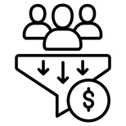
Background
What Is the Agentic Data Workflow System?
Automate Pipeline Construction
Using a System of Agents
Problem Statement:
This project aims to develop a deterministic agentic system that simplifies data workflow creation

Slide 4




Problem Statement
Data Sources
+
Use Cases
+
Stakeholder
Requirements
Requirement Analysis
Monitoring
Design
Deployed Pipeline
Team of Engineers
Implementation
Replace with
Data Sources
+
Use Cases
+
Stakeholder
Requirements
Requirement Analysis
Monitoring
Design
Deployed Pipeline
Data Engineer
Agent
Implementation
Notes:
too much contrast
tone it down a bit
optional
combine it with the next

Slide 5

Objectives
1. Set up a deterministic agent system that automates pipeline creation
2. Agents recommend tools based on use case/scenario
3. Human oversight will refines tool selection if needed
4. A correctly configured pipeline is deployed
5. Agent-driven system guides users through pipeline creation at every step
Notes:
make it brief the heading and
icons should be in bullets
keep icons
LETS MAKE A FLOW DIAGRAM ON THE RIGHT TAHT SHOWS CHECK LIST WRENCH ETCC

Slide 6
Methodology
Notes:
Agne

Slide 7
Methodology
Research and development
- Tool stacks selection
- Agentic systems
- Tools setup techniques
- System Overview
Notes:
Agne

Slide 8
Methodology
Tool Stacks
Notes:
Agne

Slide 9
Methodology
Tools
Orchestration
Ingestion
Processing
Storage
Visualization
Airflow
MySQL
Superset
Kafka
Spark
PostgreSQL
Prefect
Nifi
Flink
MongoDB
Cassandra
Neo4j
Hadoop

Slide 10
Methodology
Supported Data types:
Output modalities:
Structured data
Semi-Structured data
Unstructured data
Mixture of the above
Store data in a database
Show data on a dashboard
Make a graph of the data
Data Velocity:
Streaming Data
Batch Data

Slide 11
Methodology
Agentic systems
Notes:
Agne

Slide 12






Agents
What are Agents?
They are computer programs that exhibit the following properties:
1. Autonomous
4. Intents
2. Goal Driven
5. Beliefs
3. Reactive
6. Desires

Slide 13
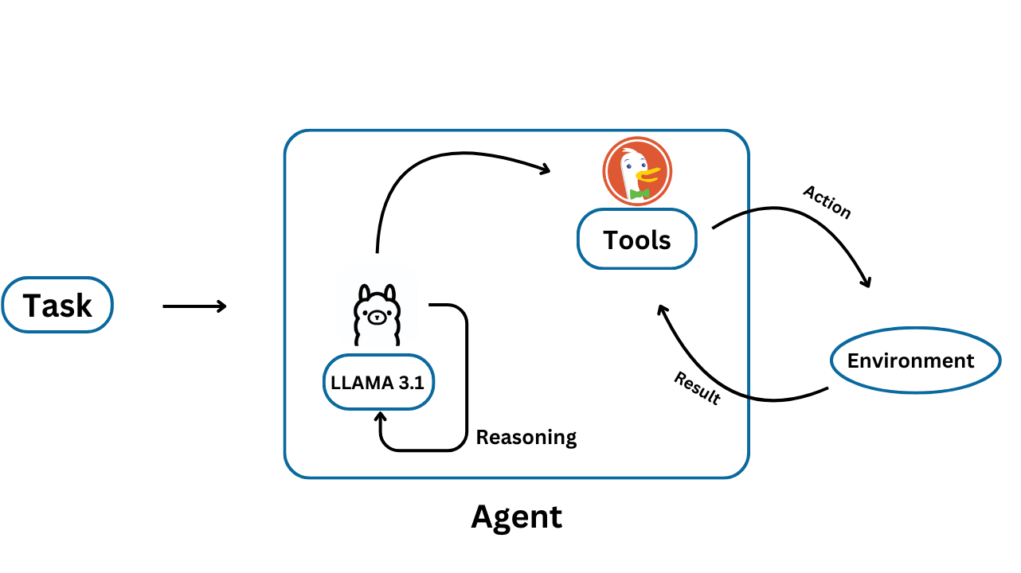
Agents
How do agents work?
- They can access other tools
- They can perceive and react to their environments
- Can make decision based on some algorithm or heuristic
Notes:
add more reasons

Slide 14
Agents
Types Of Agents:
- Utility Based Agents:
- Measure Quality of Outcomes
- Learning Agents:
Increasing Complexity
- Improve their performace over time with experience
- Rational Agents:
- Aim to produce optimal solution

Slide 15
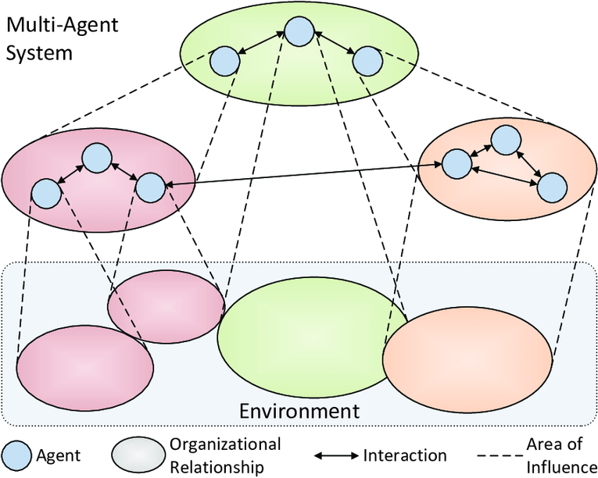
Multi Agent System
Multi Agent System
An agent can interact with another agent to achieve a common goal
Three basic architectures:
Collaboration
Supervision
Hierarchical Teams
Notes:
fix the sentence
multi agents interact with each other to achieve common goal
rephrase

Slide 16
Multi Agent System
Agents
Architecture 1: Collaboration
Sub Tasks
Divide and Conquer
Task
Large Tasks divided into smaller sub-tasks
Each subtask designated to an agent

Slide 17
Multi Agent System
Subordinates
Architecture 2: Supervision
Tasks
Has a central agent, the supervisor
Supervisor
Supervisor agent is responsible for assigning tasks to other agents
Multiple agents working on different parts of the problem

Slide 18
Multi Agent System
Architecture 3: Hierarchical
Built on top of Supervision Architecture
Supervisor
Supervisor
Has multiple supervisors forming
hierarchy
Useful for complex systems

Slide 19
Multi Agent System
Deterministic Agents:
LLM-Based Agents:
1. Follow strict rule-based logic; predictable.
1. Leverage probabilistic reasoning; unpredictability.
2. Adapt to user constraints without variability.
2. Responses may vary even with the same input due to randomness
3. Transparent workflows
3. Blackbox

Slide 20
Multi Agent System
We opted for deterministic agents
Ensures repeatable and error-free outcomes
Transparent so easy to audit and debug
Easier for the use of uninformed user who might have give unrealistic requirements
Choice of MAS Architecture and Agent:
Supervision Architecture with Heuristic-Based Agents

Slide 21
Methodology
Tool Setup

Slide 22


Tool Setup
Given a set of tools, how do we set them up?
Tools
Deployed Pipeline
Agent
Setup Architecture

Slide 23

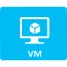
Tool Setup
Common Deployment Strategies:
1. Directly on Host OS
2. Virtual Machines
3. Containerized Setup

Slide 24
Tool Setup
Containerized Setup:
1. The software is packaged in containers
2. Software runs the same way on any computer, cloud, or server.
3. Need more power? Just start more containers to handle the load.

Slide 25
Methodology
System Overview

Slide 26
Methodology
Constraints
11 Tools
Human in the Loop Deployment
End to end
Interactive UI
Agentic Workflow

Slide 27
Methodology
Agents’ Responsibilities :
- Pipeline Requirement Collection
- Data Flow Orchestration
- Intelligent Configuration
- Automated Deployment
- User Enablement

Slide 28






Agentic WorkFlow
Requirement Collection
Users provide data requirements using a prompt-based form
Tool Selection
The system recommends compatible tools for pipeline stages
Configuration
Users refine tool configurations and system ensures compatibility
Deployment
Tools are deployed in containerized environments
Provide
Access
The final pipeline’s ports and access links are provided

Slide 29
Implementation

Slide 30
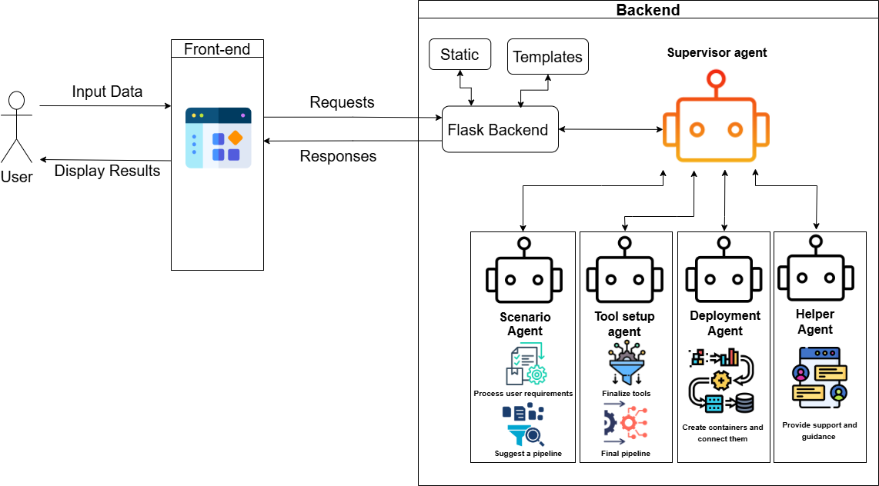
System Architecture

Slide 31
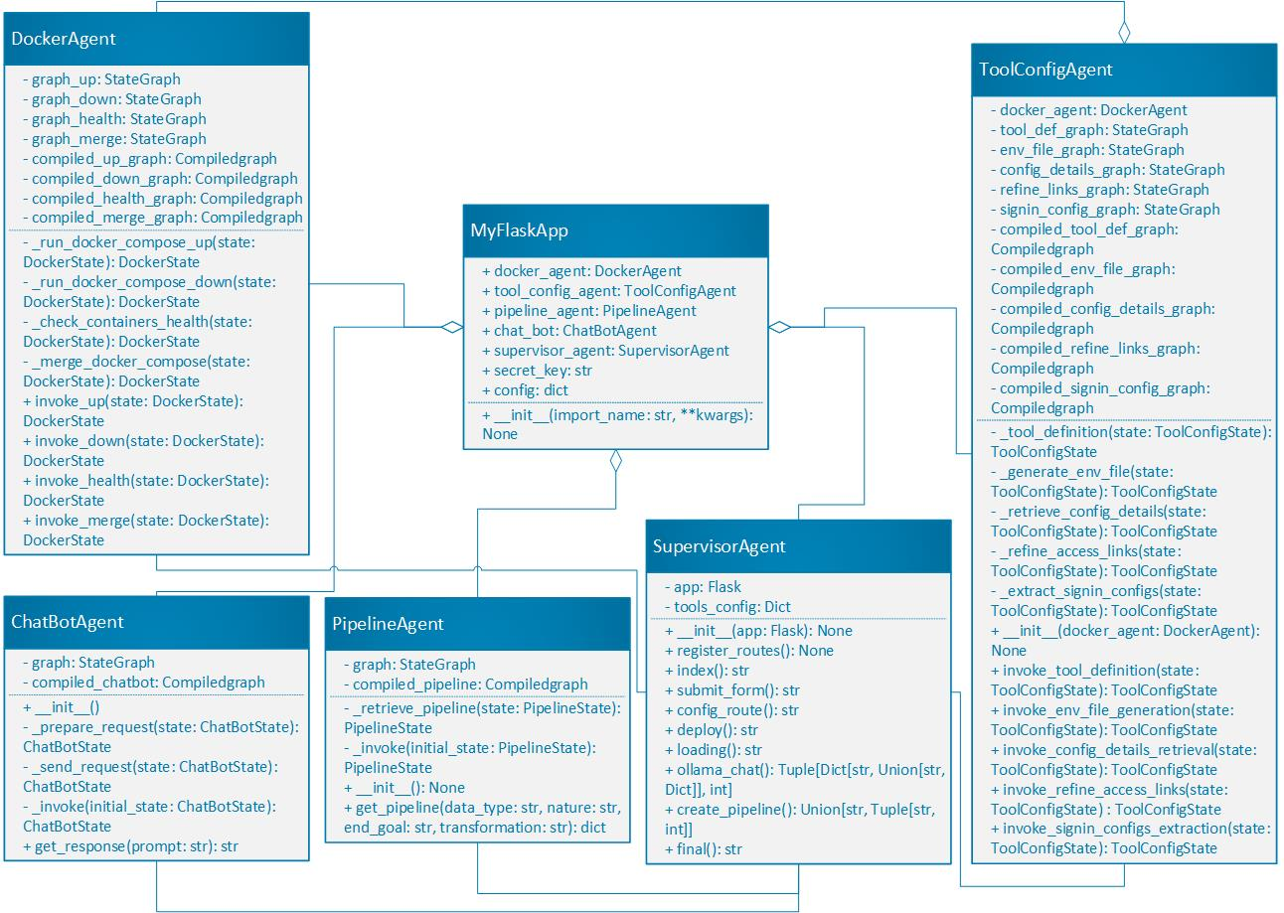
Class Diagram

Slide 32
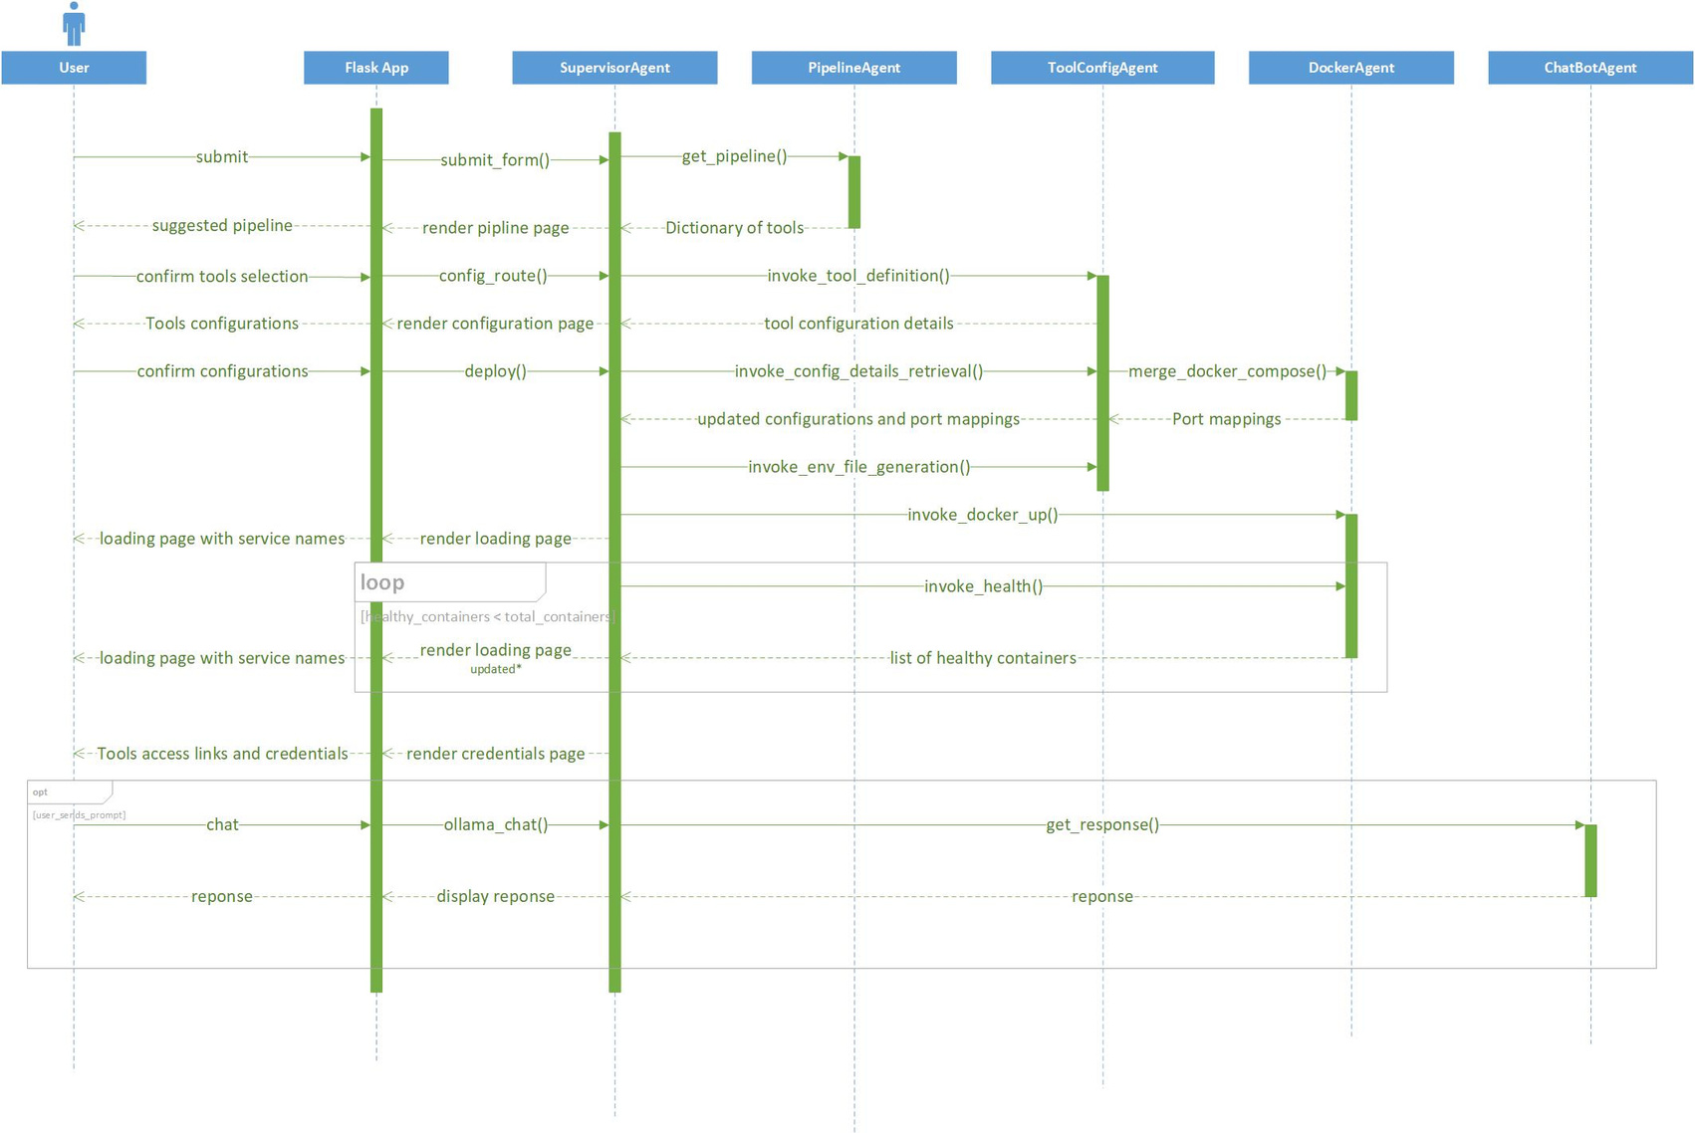
Sequence Diagram

Slide 33
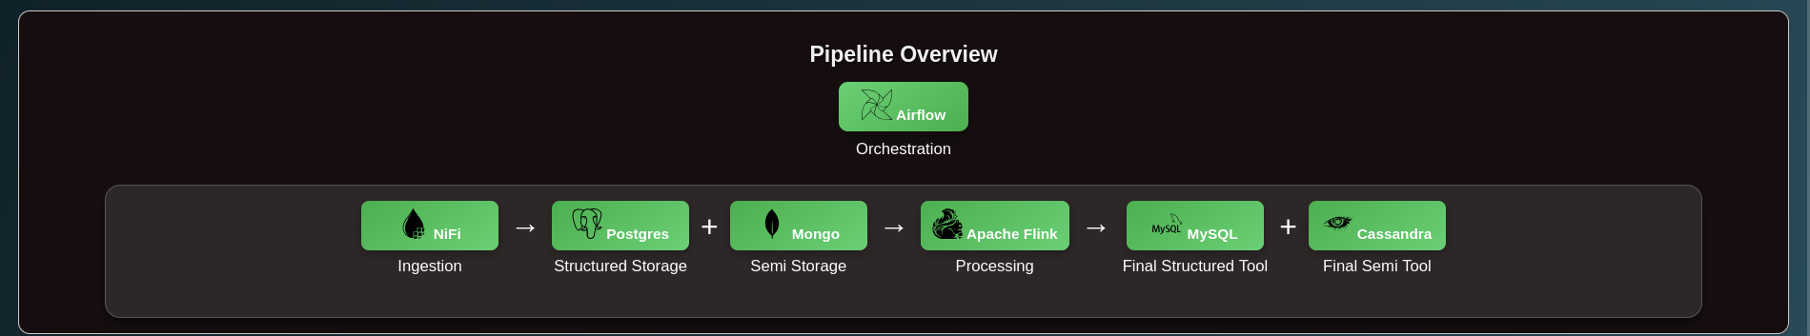
Agentic WorkFlow
Scenario Agent
Responsibilities:
1. Determines the optimal pipeline configuration based on the user requirements
2. Searches and provides any other compatible tools alternatives the user may wish to use

Slide 34

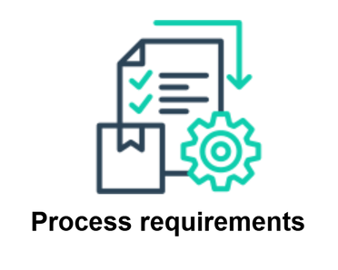
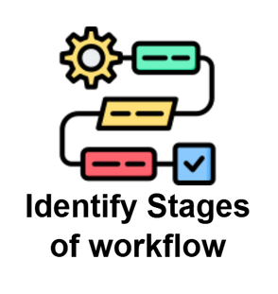
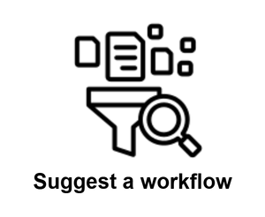
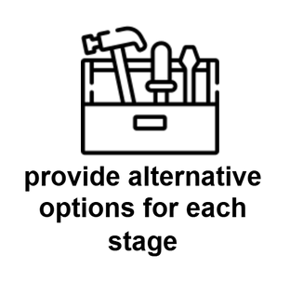
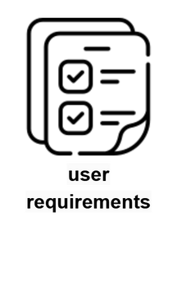
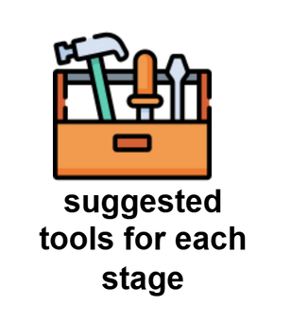
Agentic WorkFlow
Scenario Agent
Process Requirements
Identify stages of workflow
Suggest a workflow
Provide alternative options for each stage
User Requirements
Select tools for each stage

Slide 35
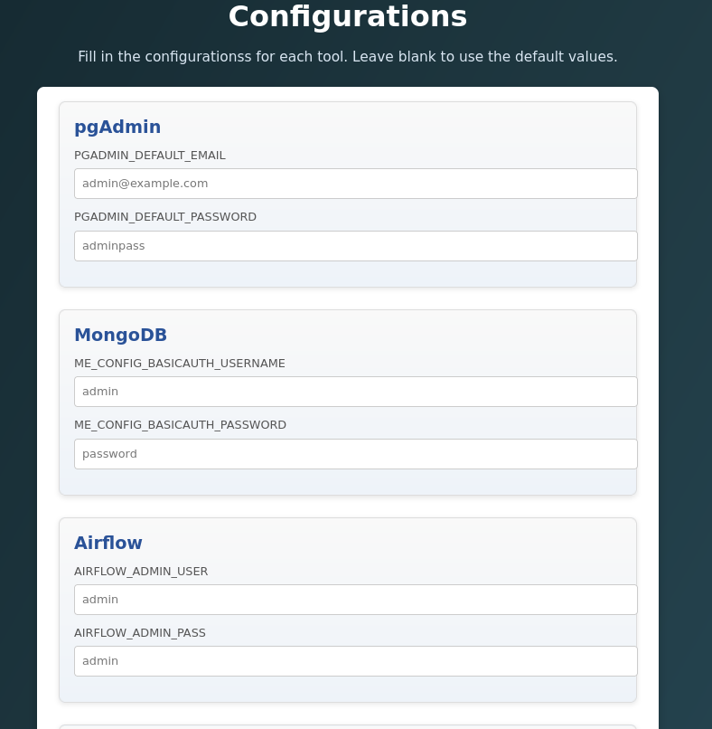
Agentic WorkFlow
Tool Setup Agent
Responsibilities:
1. Configures the tools to connect to each other without user input
2. Allow the user to chime in with any additional configuration they wish to change
3. Validate the user’s desired configurations to ensure they are acceptable

Slide 36
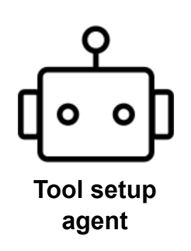
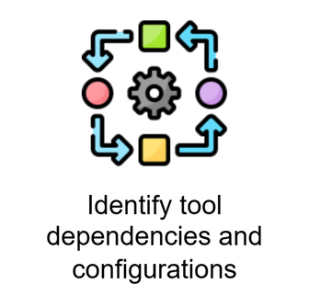
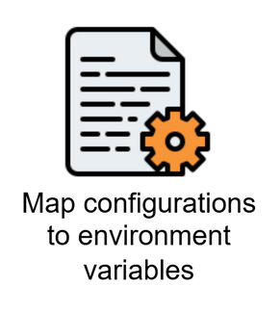
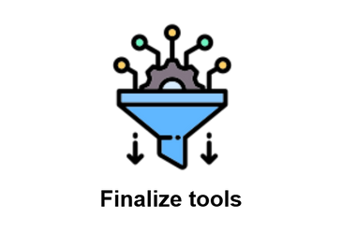

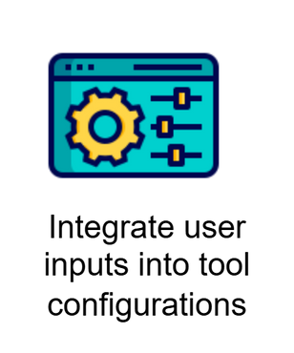
Agentic WorkFlow
Tool Setup Agent
Identify tool dependencies and configs
Map configurations to environment variables
Finalize Tools
Final Workflow
Integrate user inputs into configurations

Slide 37
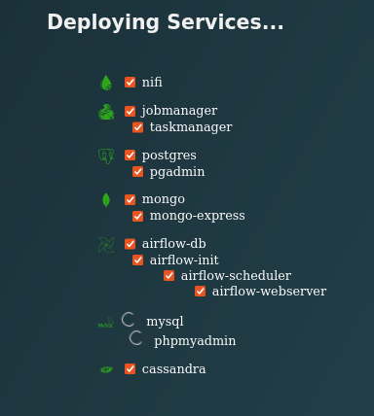
Agentic WorkFlow
Deployment Agent
Responsibilities:
1. Find and resolve all port conflicts amongst the service
2. Run and execute all dependencies and wait for a response from their health checks before executing parent
3. Monitor logs from terminal and notify the user in case of service failure

Slide 38
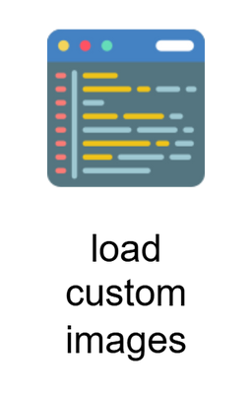
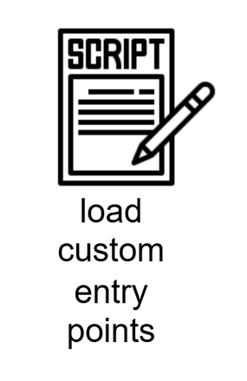

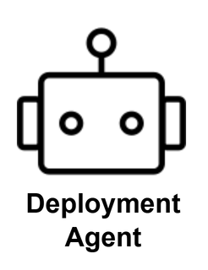

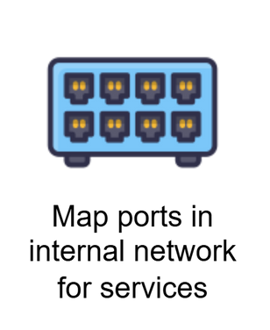
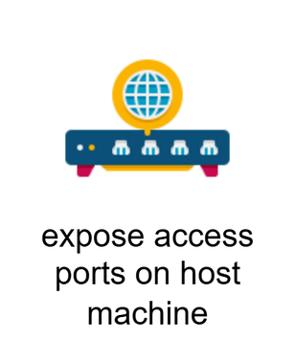
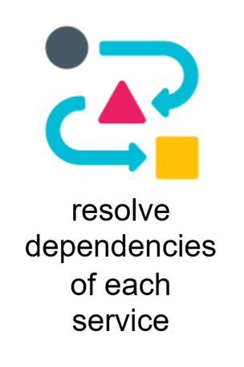
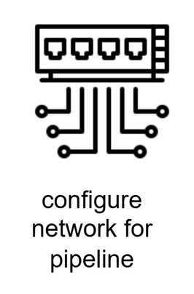
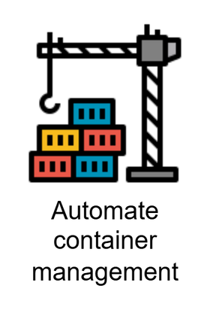
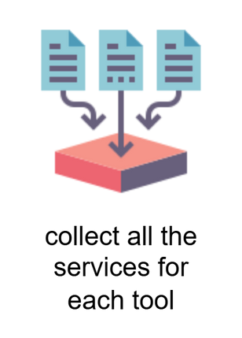
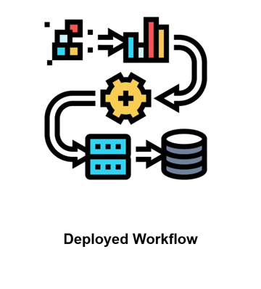
Agentic WorkFlow
Deployment Agent
Docker Environment Variables
Load custom images
Load custom entry-points
Load health checks
Find Dependencies
Conflict Resolution
Deployment
Resolve dependencies for each service
Mount volumes
Configure network for pipeline
Map ports in internal network for services
Expose access ports on host machine
Automate container management
Collect all services for each tool
Deployed workflow

Slide 39
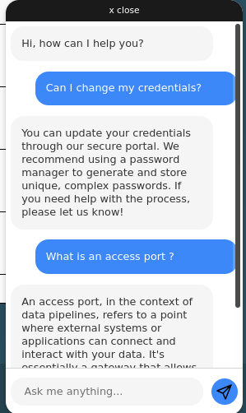
Agentic WorkFlow
Helper Agent
Responsibilities:
Provide user with assistance at every step of the deployment process
Return brief and concise response pertaining to the query

Slide 40
Deployment

Slide 41
Deployment
Containerized Deployment is done using Docker
1. Has its own underlying network that unifies all containers
2. It can be dynamically configured as it is only a YAML file
3. A single command is sufficient to launch all the services at once
4. Isolates networks, volumes, and configurations so all the applications can be run on host’s device

Slide 42
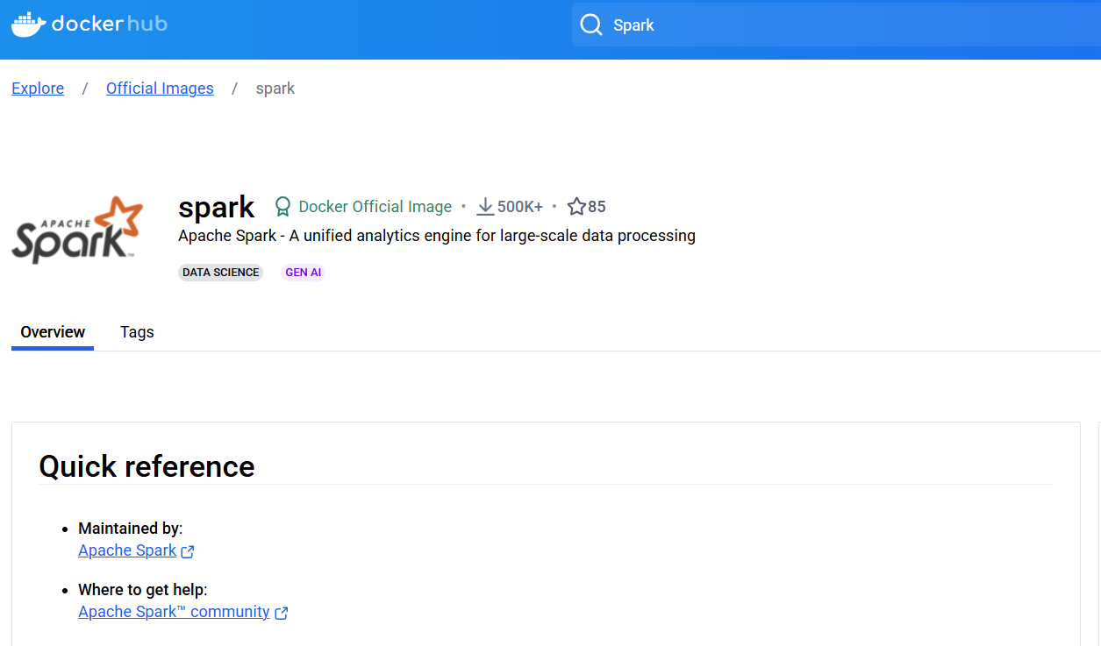
Deployment
Docker Workflow
Pulled Official/Custom images for each of the tools/services under consideration
Spark image pulled from DockerHub

Slide 43
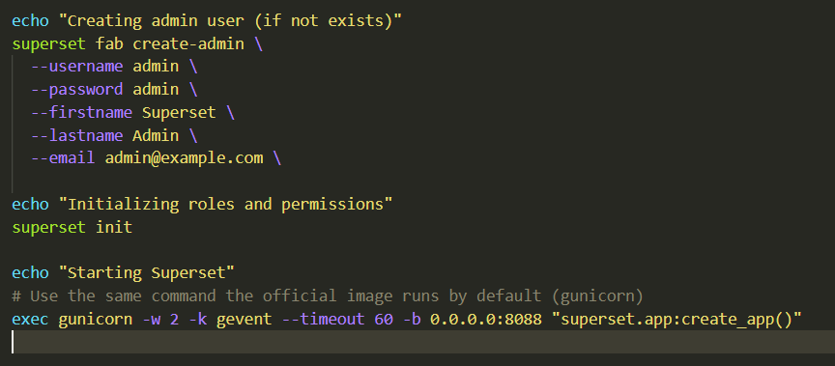
Deployment
Docker Workflow
Created entrypoint functions in bash to configure executables
Bash Script for entry-points

Slide 44
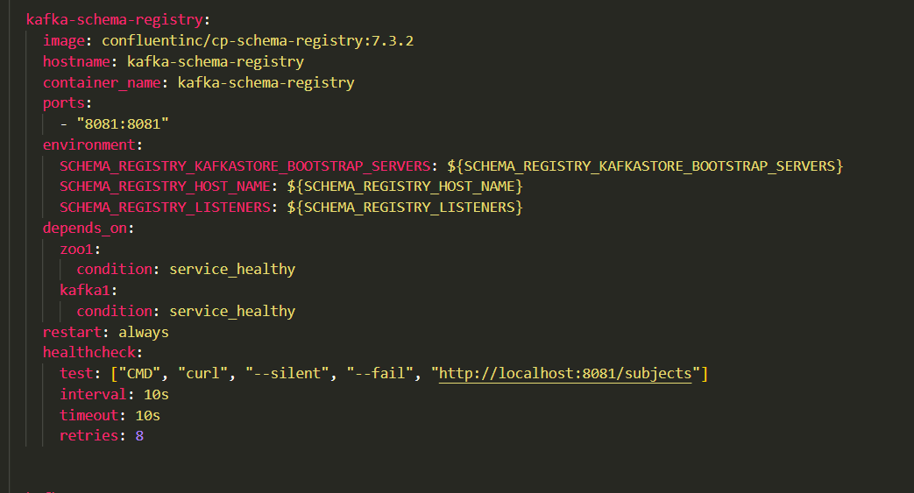
Deployment
Docker Workflow
Certain services needed dependencies, additional docker images that needed to be pulled and configured
Dependency Handling

Slide 45
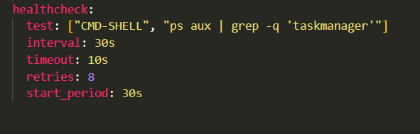
Deployment
Docker Workflow
Health checks for each of the services and subservices had to be written independently
Similar health checks written for each service

Slide 46
Sample Workflow

Slide 47
Sample WorkFlow
Requirements
Proposed Pipeline
1. Semi-structured Data
1. Ingest Data using NiFi
2. Requires Staging area
2. Store in MongoDB
3. Needs to implement transformation
3. Create a Spark job to process it
4. Store in parquet file
4. Store in HDFS using Hadoop

Slide 48
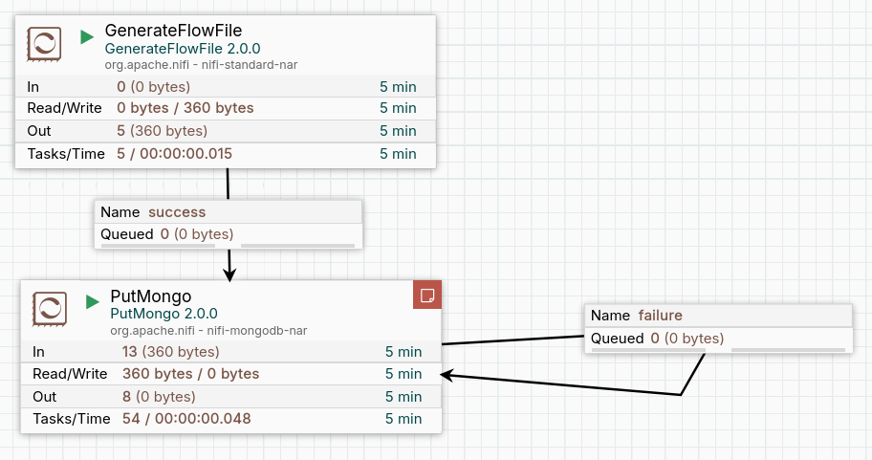
Sample WorkFlow
Generate flow is a NiFi function that automatically generates a stream of data
It is sent to MongoDB
7

Slide 49
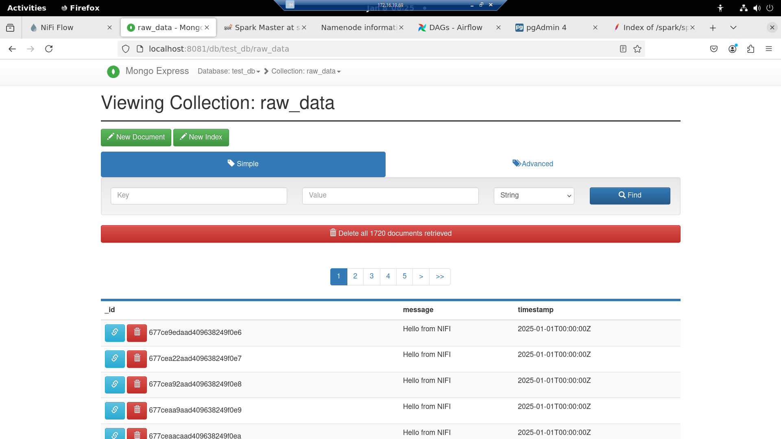
Sample WorkFlow
Data received by MongoDB

Slide 50
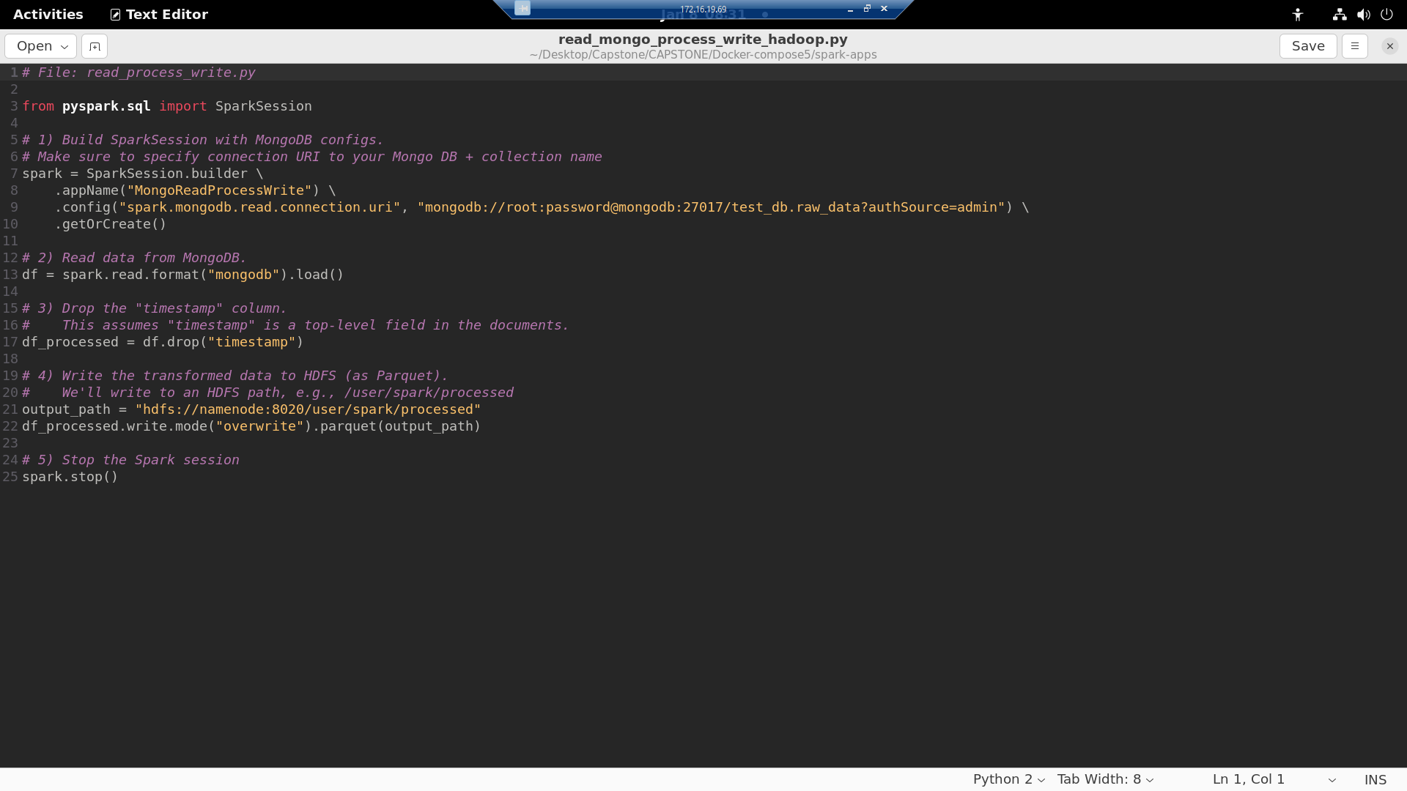
Sample WorkFlow
Spark Session created
and connected to Mongo
Column is dropped
Dumped as HDFS
7

Slide 51
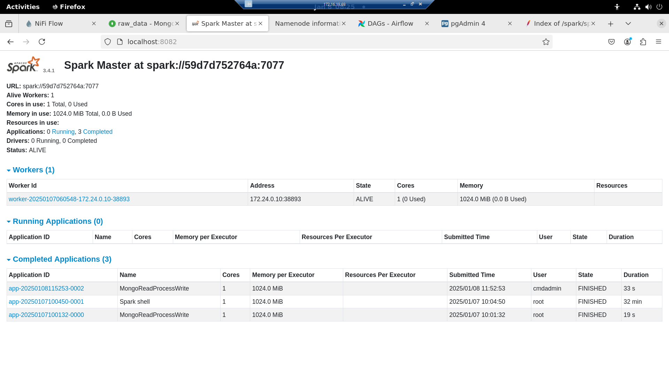
Sample WorkFlow
Spark Process Completed

Slide 52
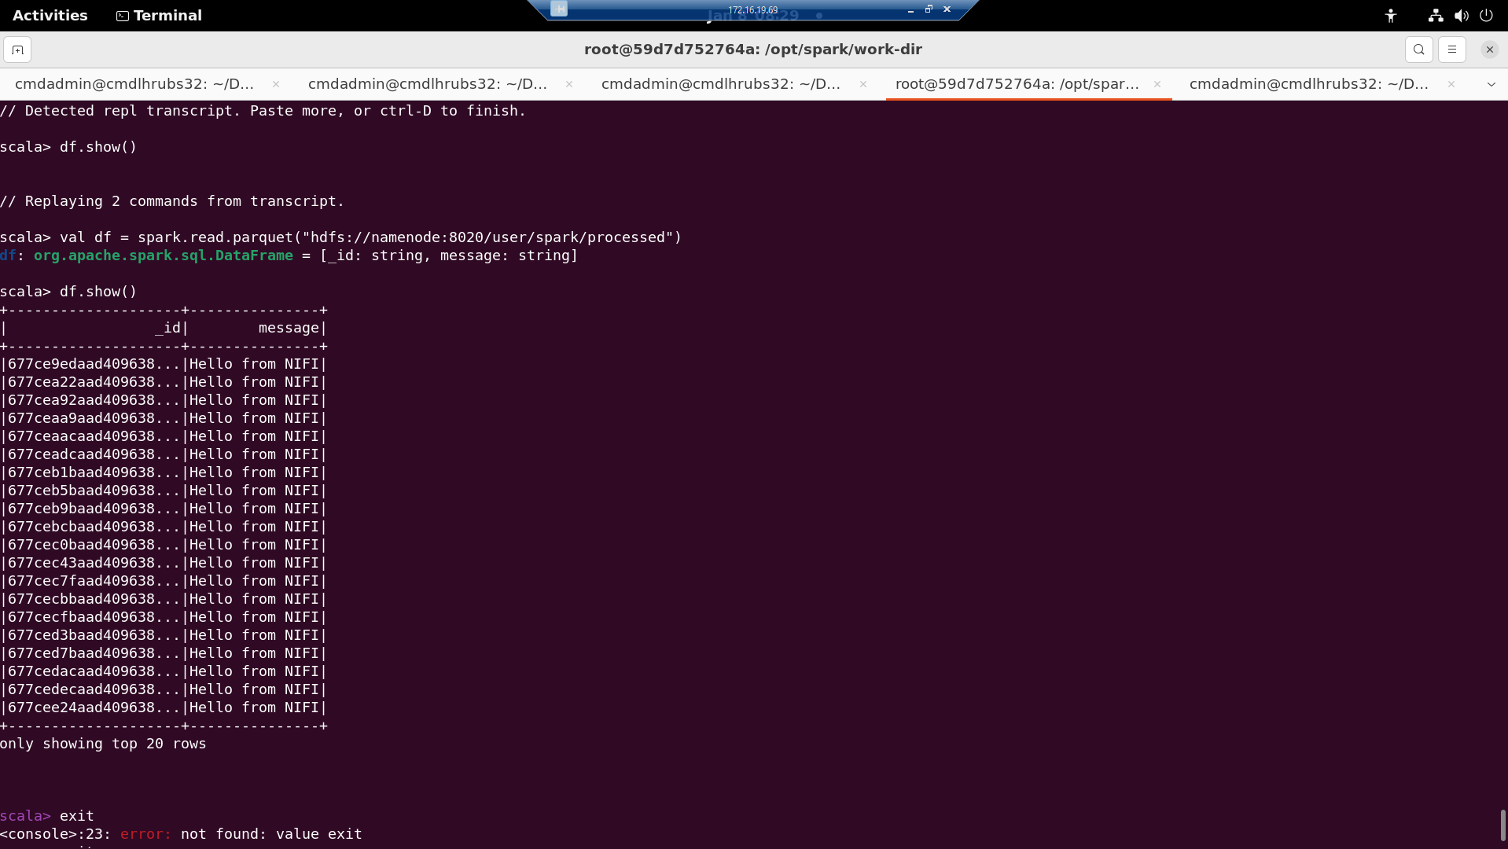
Sample WorkFlow
Final Data in Hadoop Parquet with dropped column

Slide 53
System Evaluation
Users can deploy pipelines efficiently within 8 to 15 minutes of accessing the form
This simplifies workflow creation by removing the need for advanced configuration expertise
It ensures accessibility even for those with limited technical knowledge.
Notes:
Also discuss the metrics discussed earlier to jog the viewer's memory. Say that this will reduce deployment time by at least few days because architecture doesn’t need to be learned from scratch

Slide 54
Limitations and Improvements

Slide 55



Project Achievements
Data Types
Data Velocity
Tools
Use Case
1. Structured
1. Batch
1. Storage
1. Storage
PostgreSQL
MySQL
MongoDB
Cassandra
Hadoop
Neo4j
2. Unstructured
2. Streaming
2. Analytics
3. Semi-structured
2. Graph-based storage
4. Any combination of these
2. Processing
Apache Flink
Apache Spark
3. Ingestion
Apache Kafka
NiFi
4. Orchestration
Airflow
Prefect
5. Visualization
Superset
Notes:
4. this will require details about clusters in the configs
if a person knows this much, he can dedploy anyways
contradiction

Slide 56
Limitations
1. Data engineering projects often focus on niche, highly specific applications.
2. Big data in data engineering demands clusters, unsupported by single-node system
3. Users with expertise in tools and use cases may not require the software.
Notes:
4. this will require details about clusters in the configs
if a person knows this much, he can dedploy anyways
contradiction

Slide 57
Improvements
1. At present, there are 13 tools but this can easily be scaled with custom docker images available on DockerHub
2. Custom mages may be created for industry specific tools so it generalizes better.

Slide 58
Questions?

